Slide 1
pMFM speedup
Tian Fang

Slide 2
Overview
Parameter optimization using CMA-ES with DL Model
Parameter optimization using Gradient Descent with DL Model
With random initialization
With given initial param vectors

Slide 3
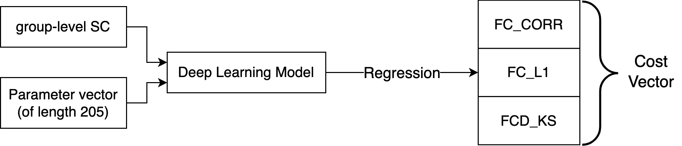
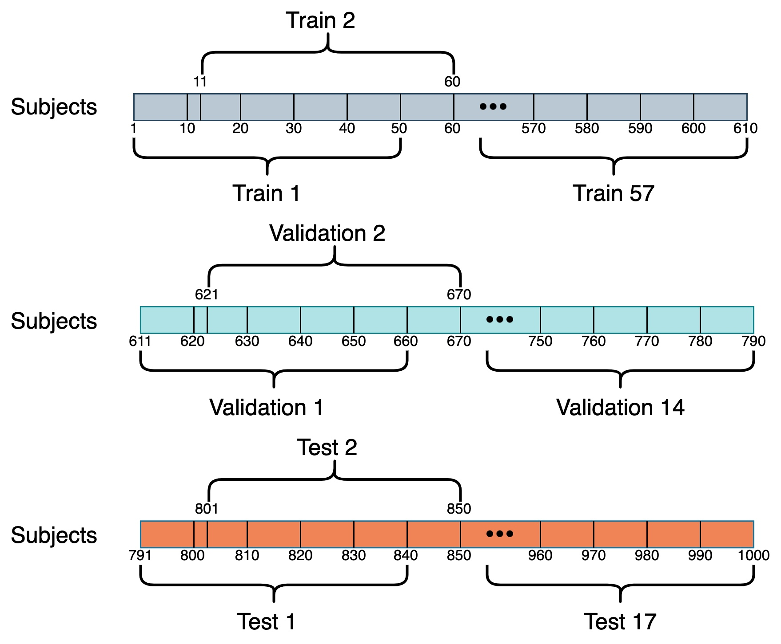
Recap: Prediction Task and Dataset
1000 subjects are split into 88 samples (50 subjects per sample)
57 training samples
14 validation samples
17 test samples
Generate 1 group-level empirical SC, FC and FCD for each sample

Slide 4
Parameter optimization using CMA-ES with DL Model

Slide 5
Deep Learning (DL) version CMA-ES
Same initialization as Euler Integration version CMA-ES
G, wEE, wEI, and 𝜎 Ranges
Range for each wEE: [1, 10]
Range for each wEI: [1, 5]
Range for each 𝜎: [0.0005, 0.01]
Range for G: [0, 3]
Use trained DL model (instead of Euler Integration) to predict costs of param vectors
Run up to 500 CMA-ES iterations, each yielding 100 children
Choose 1 param vector with the best predicted costs

Slide 6
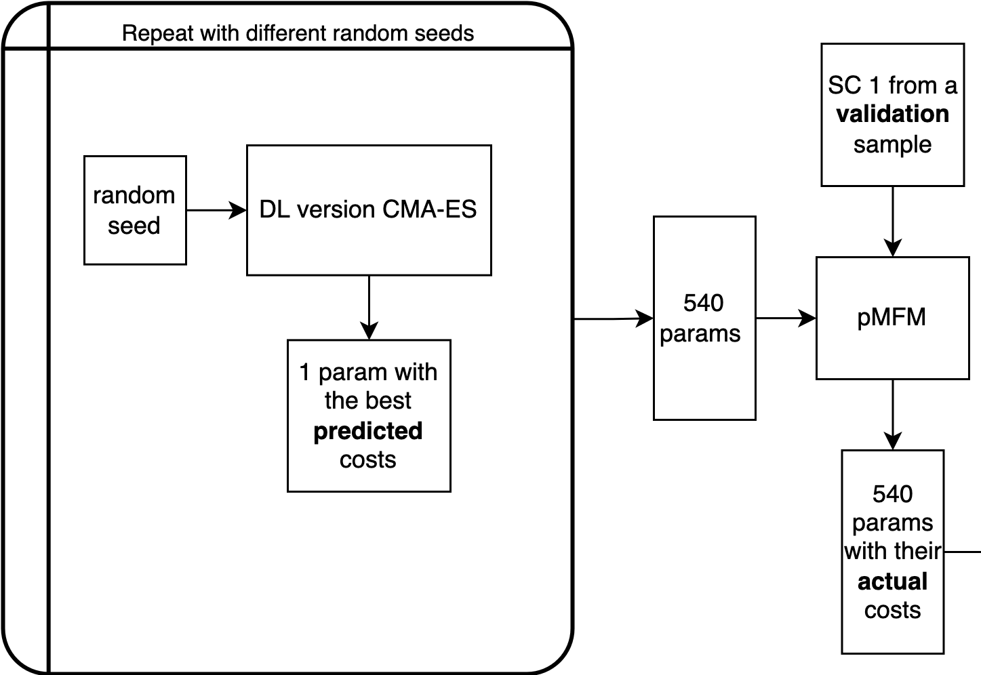
Deep Learning (DL) version CMA-ES
When 540 params are fed into pMFM, none of the excitatory firing rates are within 2.7 Hz and 3.3Hz

Slide 7
Parameter optimization using Gradient Descent with DL Model

Slide 8
Parameter optimization using Gradient Descent with DL Model
With random initialization
Randomly initialize a param vector as the initial param vectors to be fed into the Grad Desc
Gradient Descent until loss changes are small (< 1e-6), or until one or more params among 205 params are going out of range
G, wEE, wEI, and 𝜎 Ranges
Range for each wEE: [1, 10]
Range for each wEI: [1, 5]
Range for each 𝜎: [0.0005, 0.01]
Range for G: [0, 3]
80,000 random seeds tried, 498 of them yield param vectors with predicted costs lower than 0.68
However, when fed into pMFM, the excitatory firing rate is not within 2.7 Hz and 3.3Hz

Slide 9
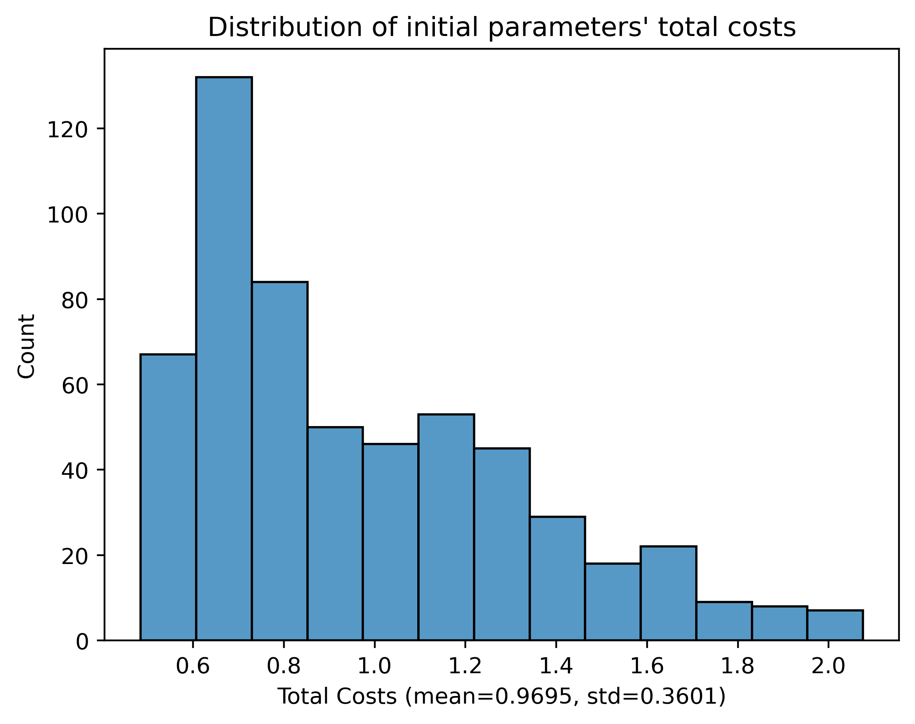
Parameter optimization using Gradient Descent with DL Model
With given initial param vectors
Randomly sample 10 param vectors from the 10,000 params optimized by forward simulation as the initial param vectors to be fed into the Grad Desc
Repeat for 57 training samples
Gradient Descent until loss changes are small (< 1e-6), or until one or more params among 205 params are going out of range
G, wEE, wEI, and 𝜎 Ranges
Range for each wEE: [1, 10]
Range for each wEI: [1, 5]
Range for each 𝜎: [0.0005, 0.01]
Range for G: [0, 3]
Total costs of the initial 570 param vectors

Slide 10
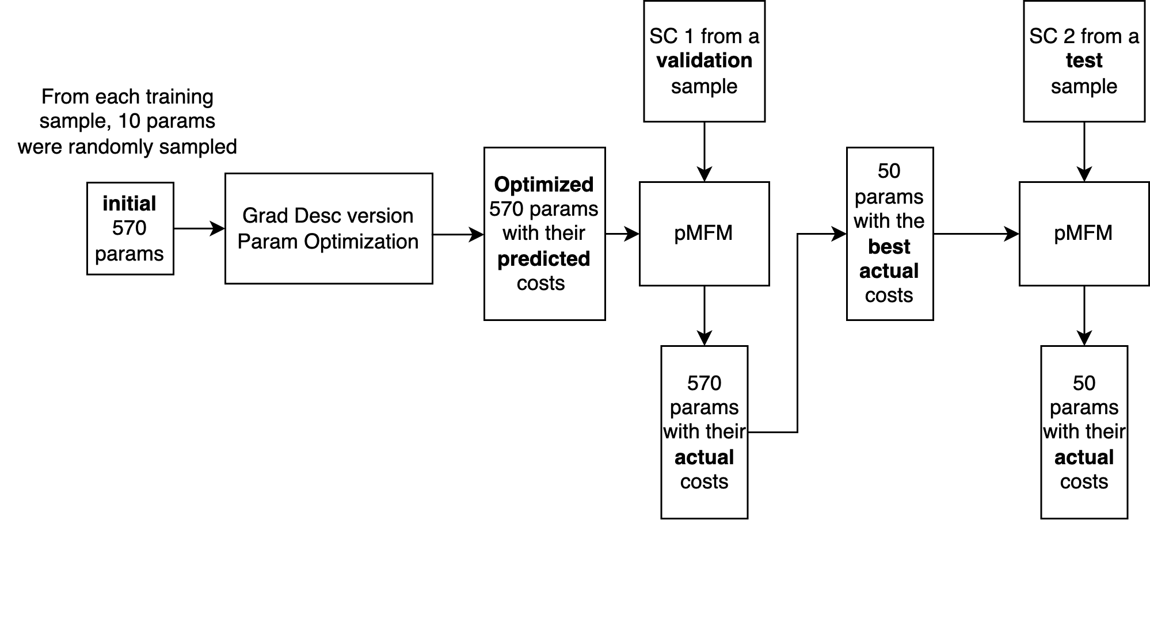
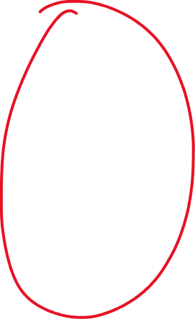
Parameter optimization using Gradient Descent with DL Model

Slide 11
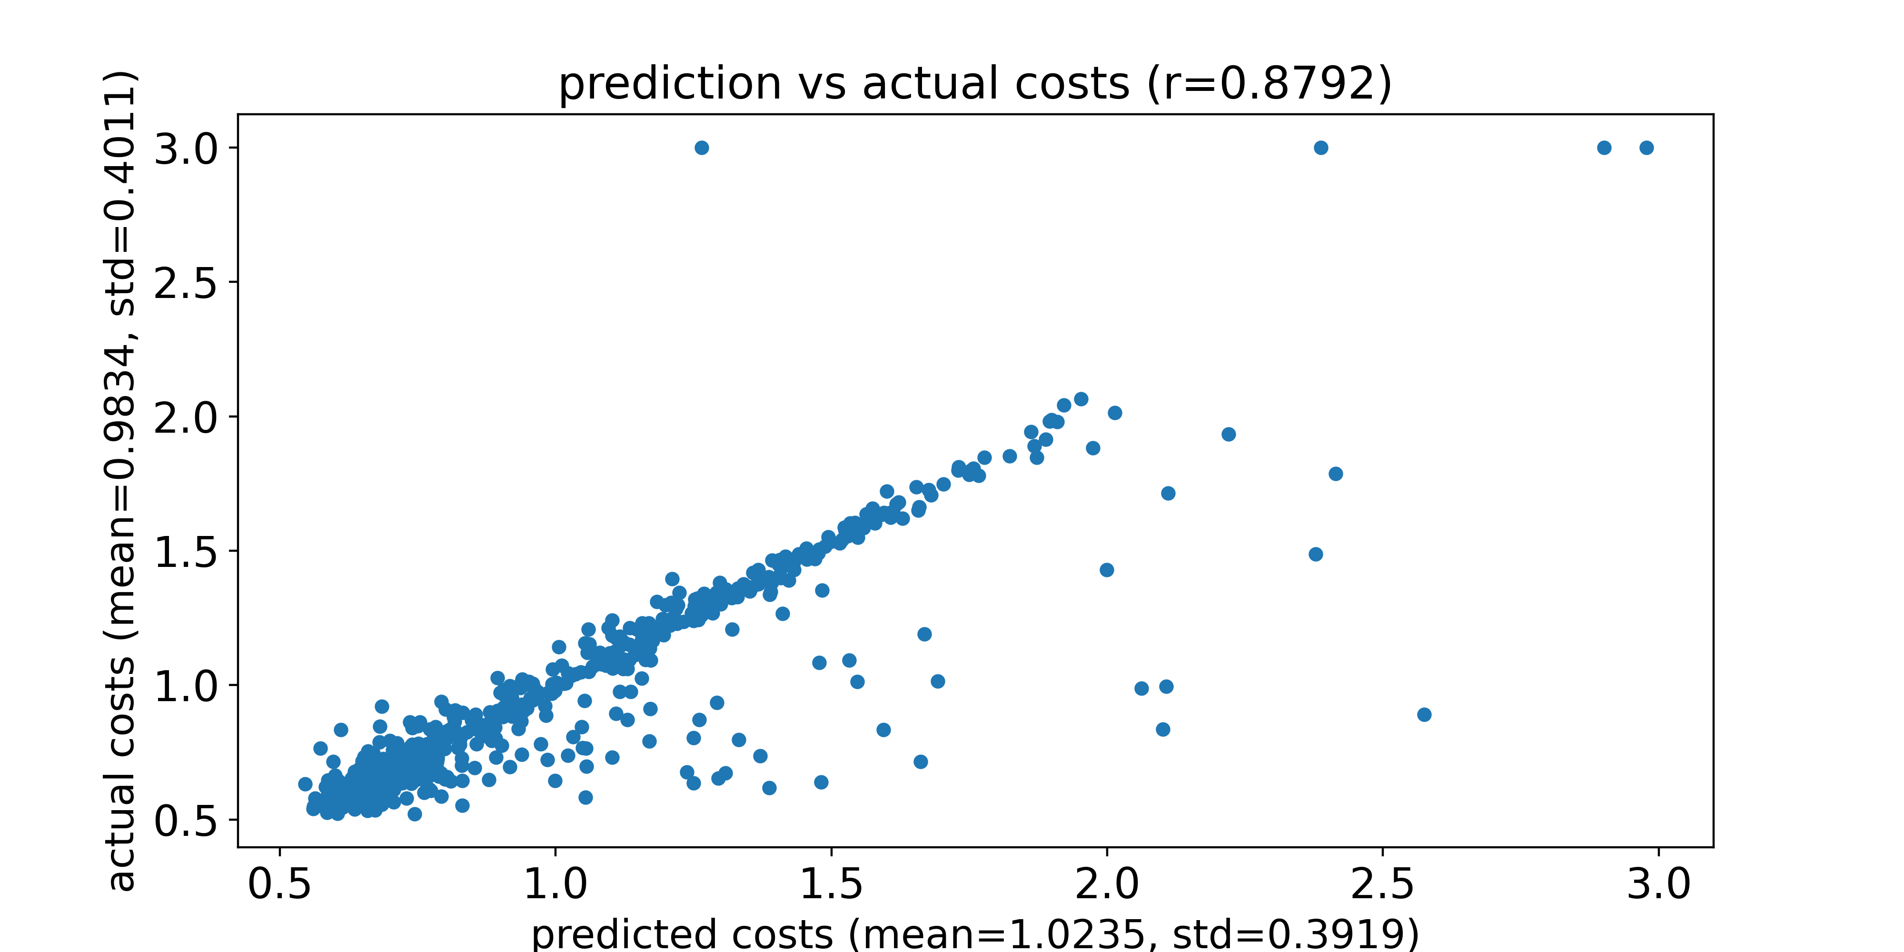
Compare prediction and actual total costs
DL model used is trained naïve net without SC
Feed the optimized 570 params and an SC from a validation sample into pMFM, and compare the prediction and the actual costs
Dots with an actual cost of 3 represent parameters that generate NaN using Euler forward simulation
Predicted costs and actual costs for an SC from a validation sample
actual costs refers to costs generated by pMFM

Slide 12
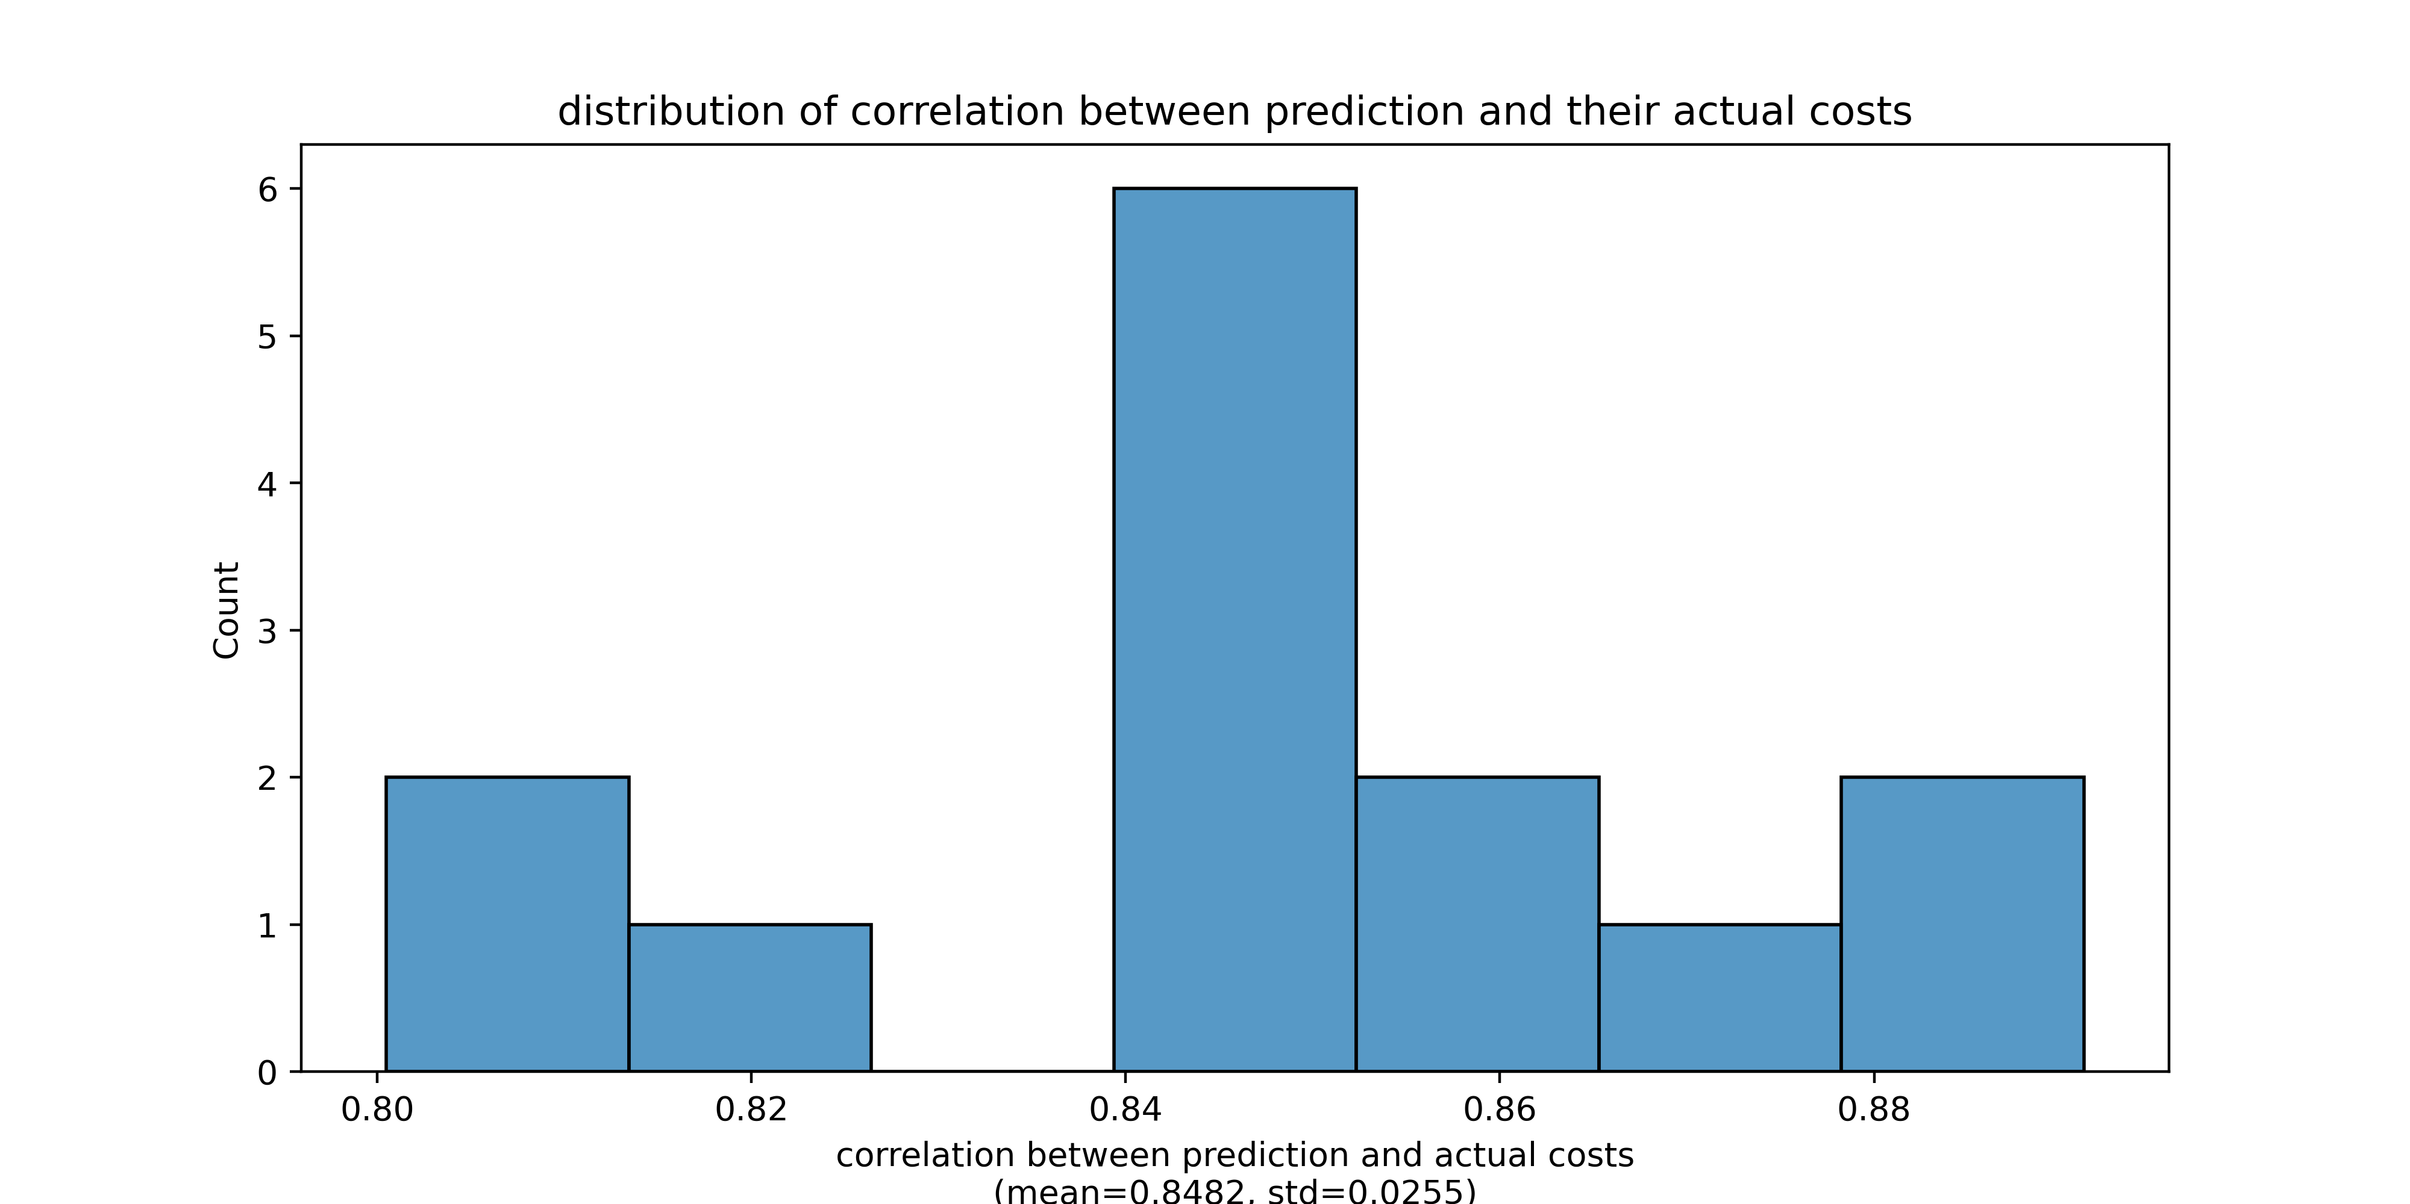
Compare prediction and actual total costs
DL model used is trained naïve net without SC
Feed the optimized 570 params and an SC from a validation sample into pMFM, and compare the prediction and the actual costs
Dots with an actual cost of 3 represent parameters that generate NaN using Euler forward simulation
Distribution of correlation when we use different validation SC

Slide 13
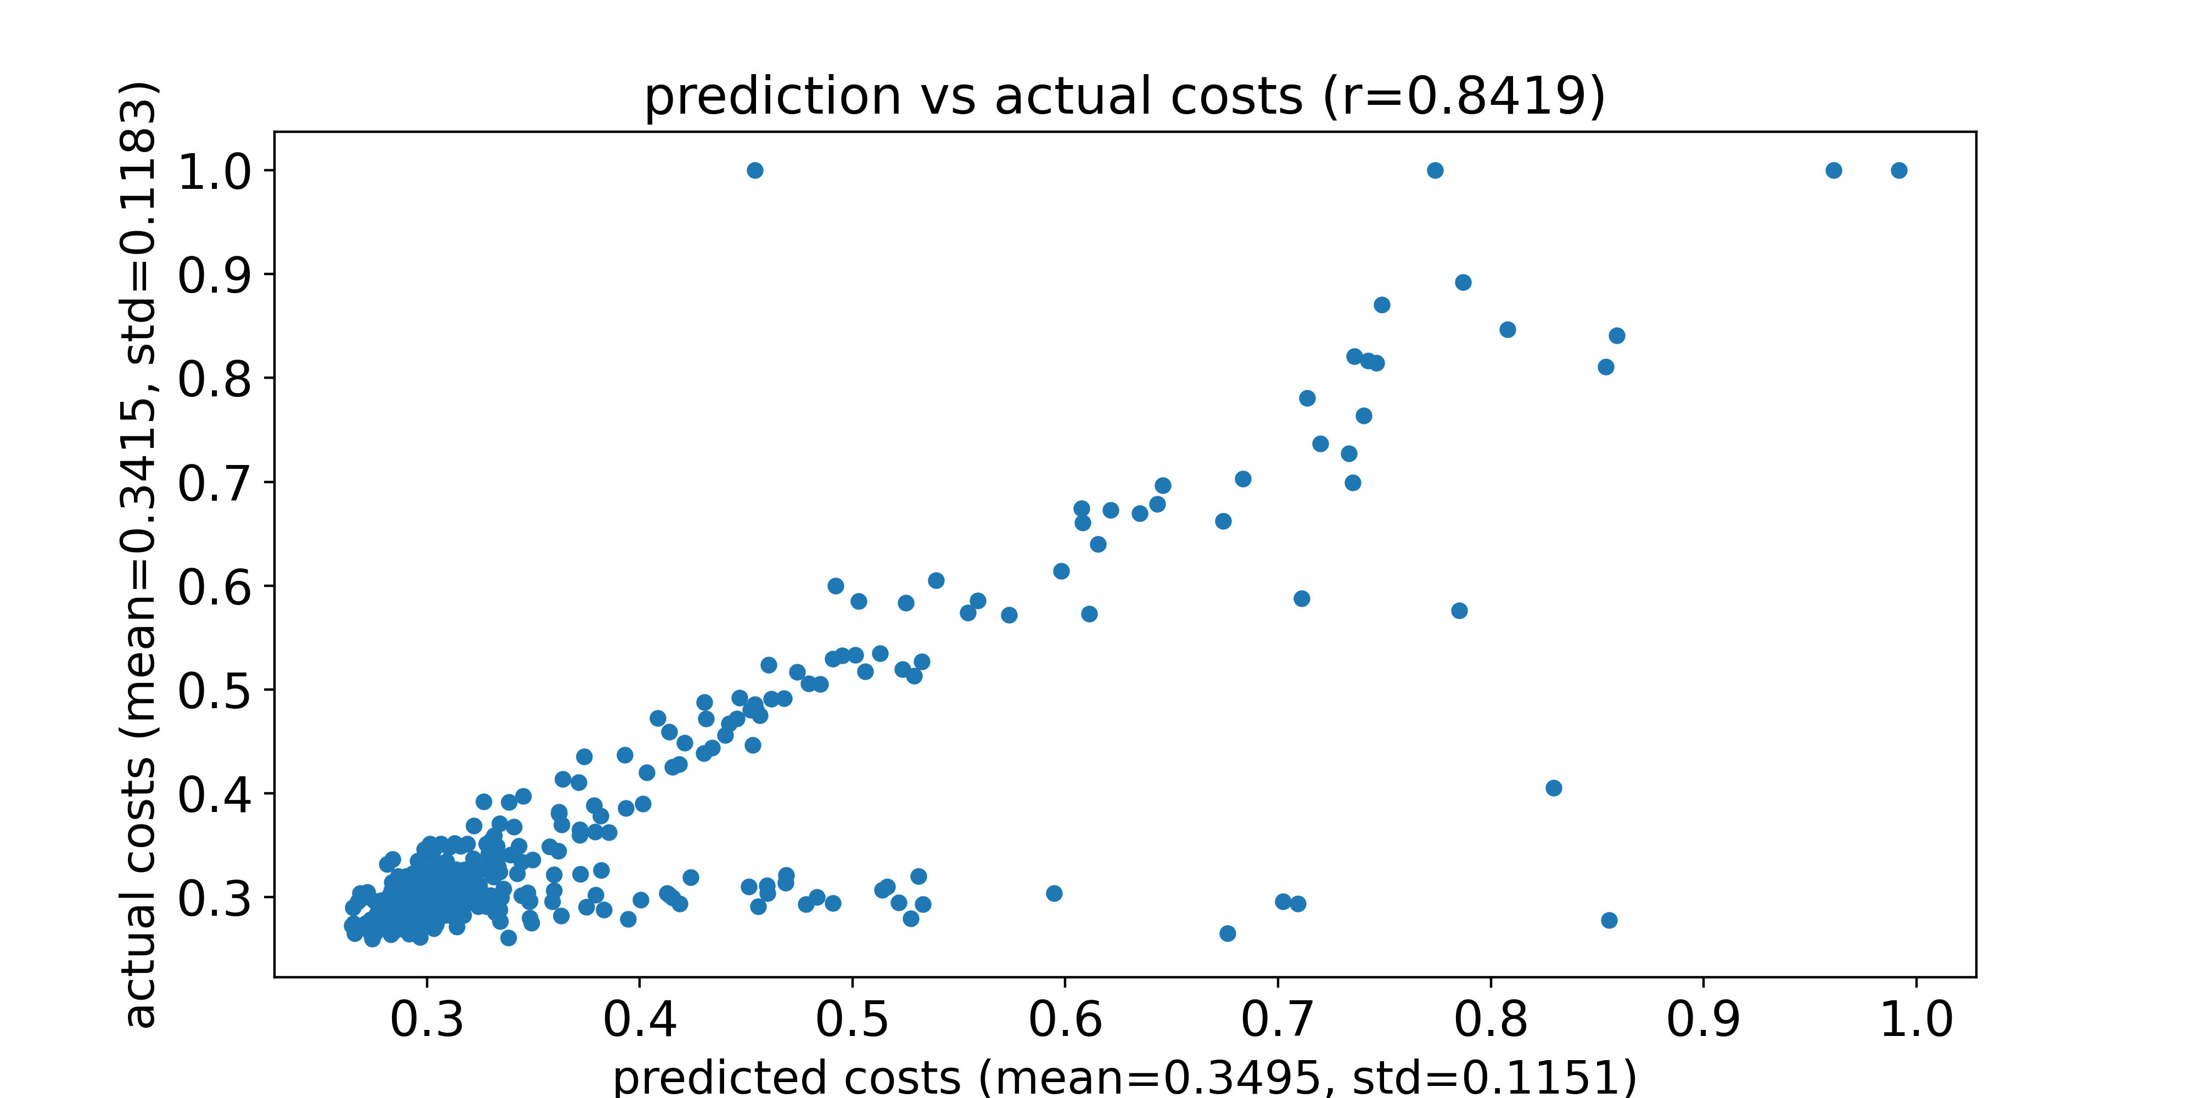
Compare prediction and actual FC_CORR costs
DL model used is trained naïve net without SC
Feed the optimized 570 params and an SC from a validation sample into pMFM, and compare the prediction and the actual costs
Dots with an actual cost of 1 represent parameters that generate NaN using Euler forward simulation
Predicted costs and actual costs for an SC from a validation sample

Slide 14
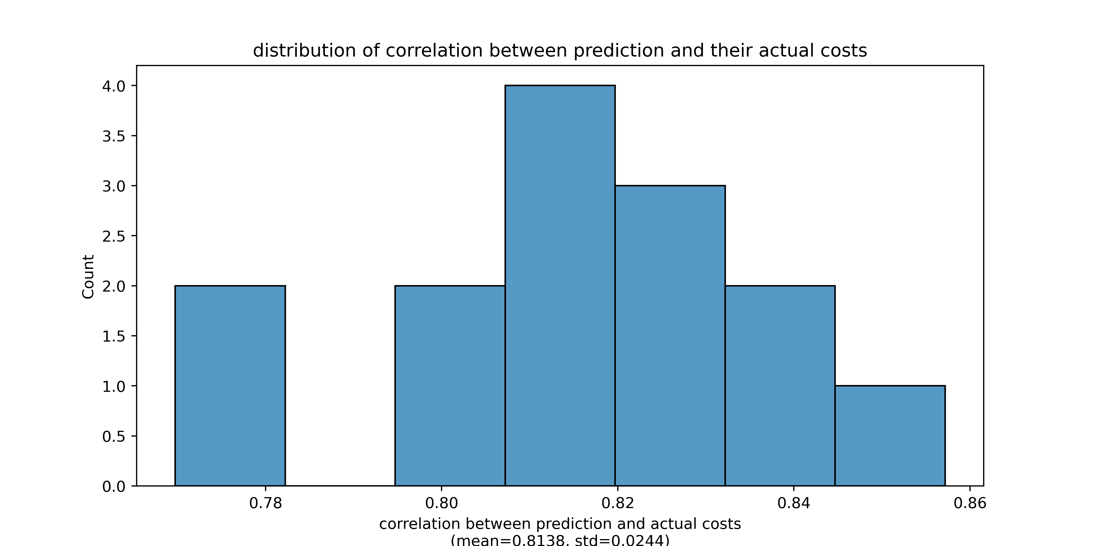
Compare prediction and actual FC_CORR costs
DL model used is trained naïve net without SC
Feed the optimized 570 params and an SC from a validation sample into pMFM, and compare the prediction and the actual costs
Dots with an actual cost of 1 represent parameters that generate NaN using Euler forward simulation
Distribution of correlation when we use different validation SC

Slide 15
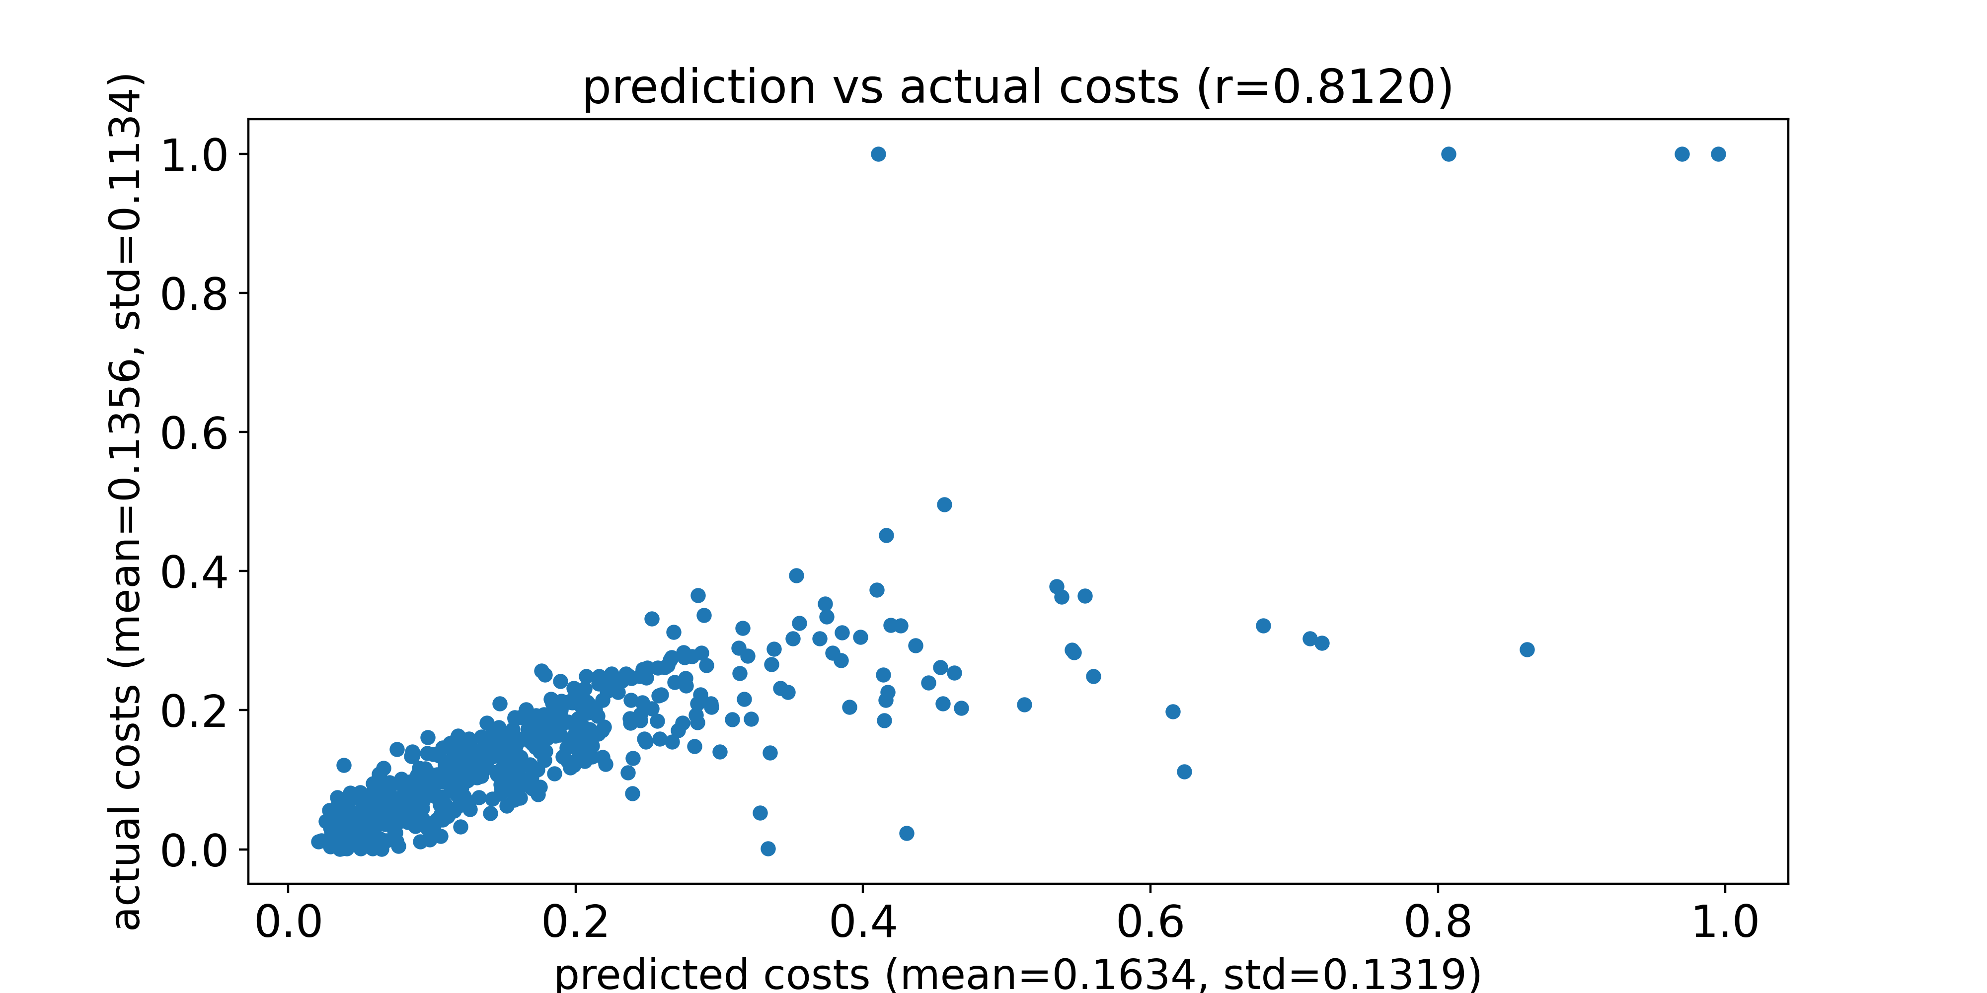
Compare prediction and actual FC_L1 costs
DL model used is trained naïve net without SC
Feed the optimized 570 params and an SC from a validation sample into pMFM, and compare the prediction and the actual costs
Dots with an actual cost of 1 represent parameters that generate NaN using Euler forward simulation
Predicted costs and actual costs for an SC from a validation sample

Slide 16
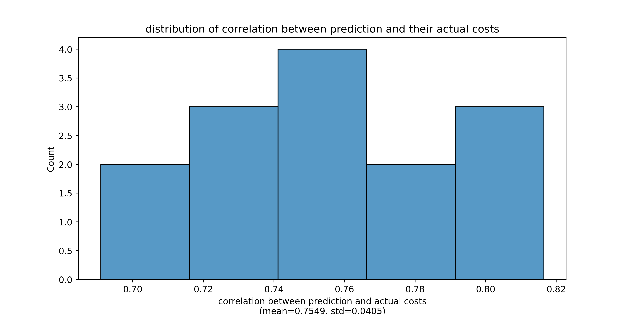
Compare prediction and actual FC_L1 costs
DL model used is trained naïve net without SC
Feed the optimized 570 params and an SC from a validation sample into pMFM, and compare the prediction and the actual costs
Dots with an actual cost of 1 represent parameters that generate NaN using Euler forward simulation
Distribution of correlation when we use different validation SC

Slide 17
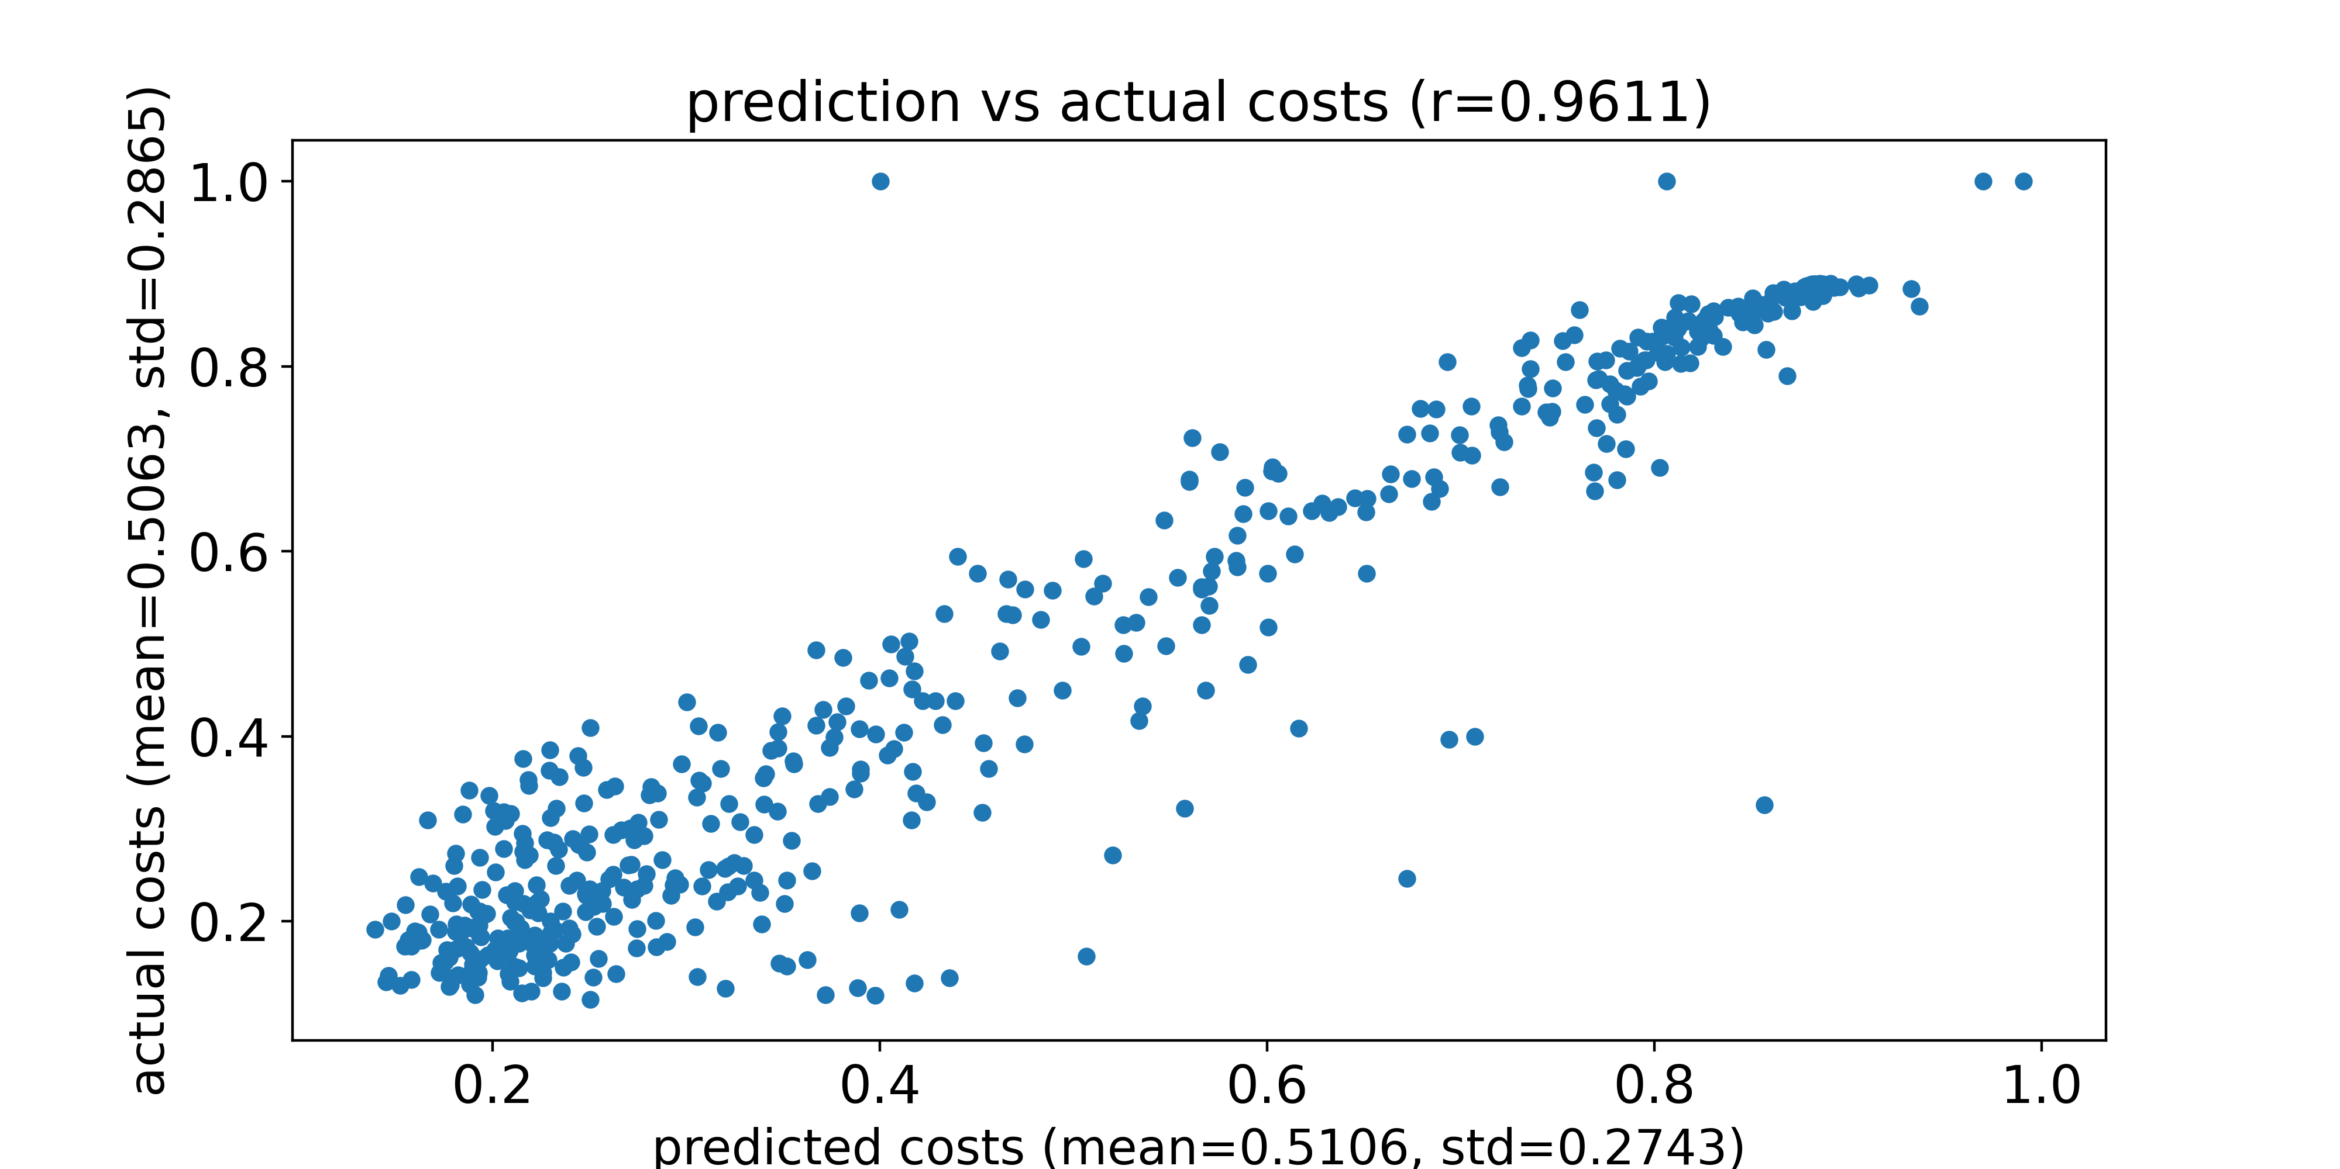
Compare prediction and actual FCD_KS costs
DL model used is trained naïve net without SC
Feed the optimized 570 params and an SC from a validation sample into pMFM, and compare the prediction and the actual costs
Dots with an actual cost of 1 represent parameters that generate NaN using Euler forward simulation
Predicted costs and actual costs for an SC from a validation sample

Slide 18
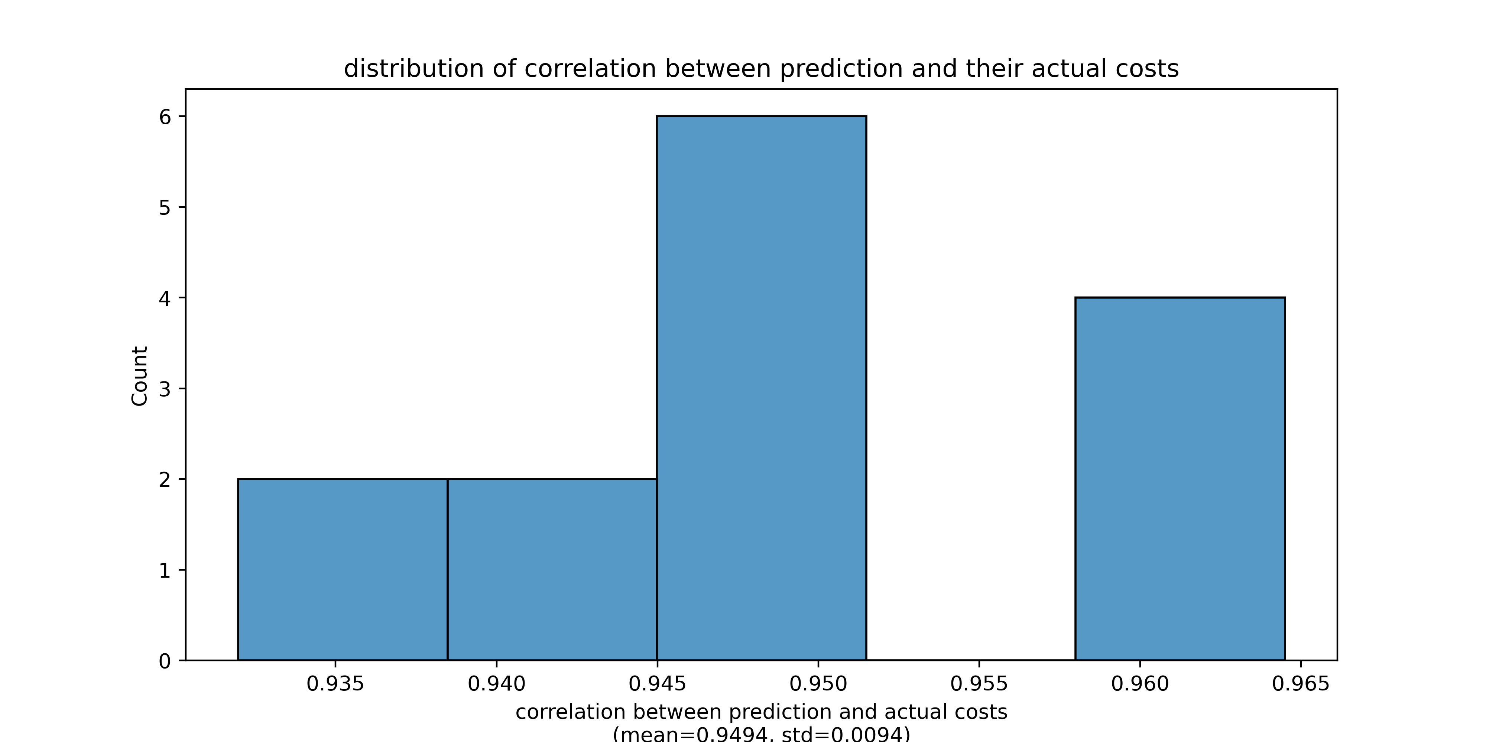
Compare prediction and actual FCD_KS costs
DL model used is trained naïve net without SC
Feed the optimized 570 params and an SC from a validation sample into pMFM, and compare the prediction and the actual costs
Dots with an actual cost of 1 represent parameters that generate NaN using Euler forward simulation
Distribution of correlation when we use different validation SC

Slide 19
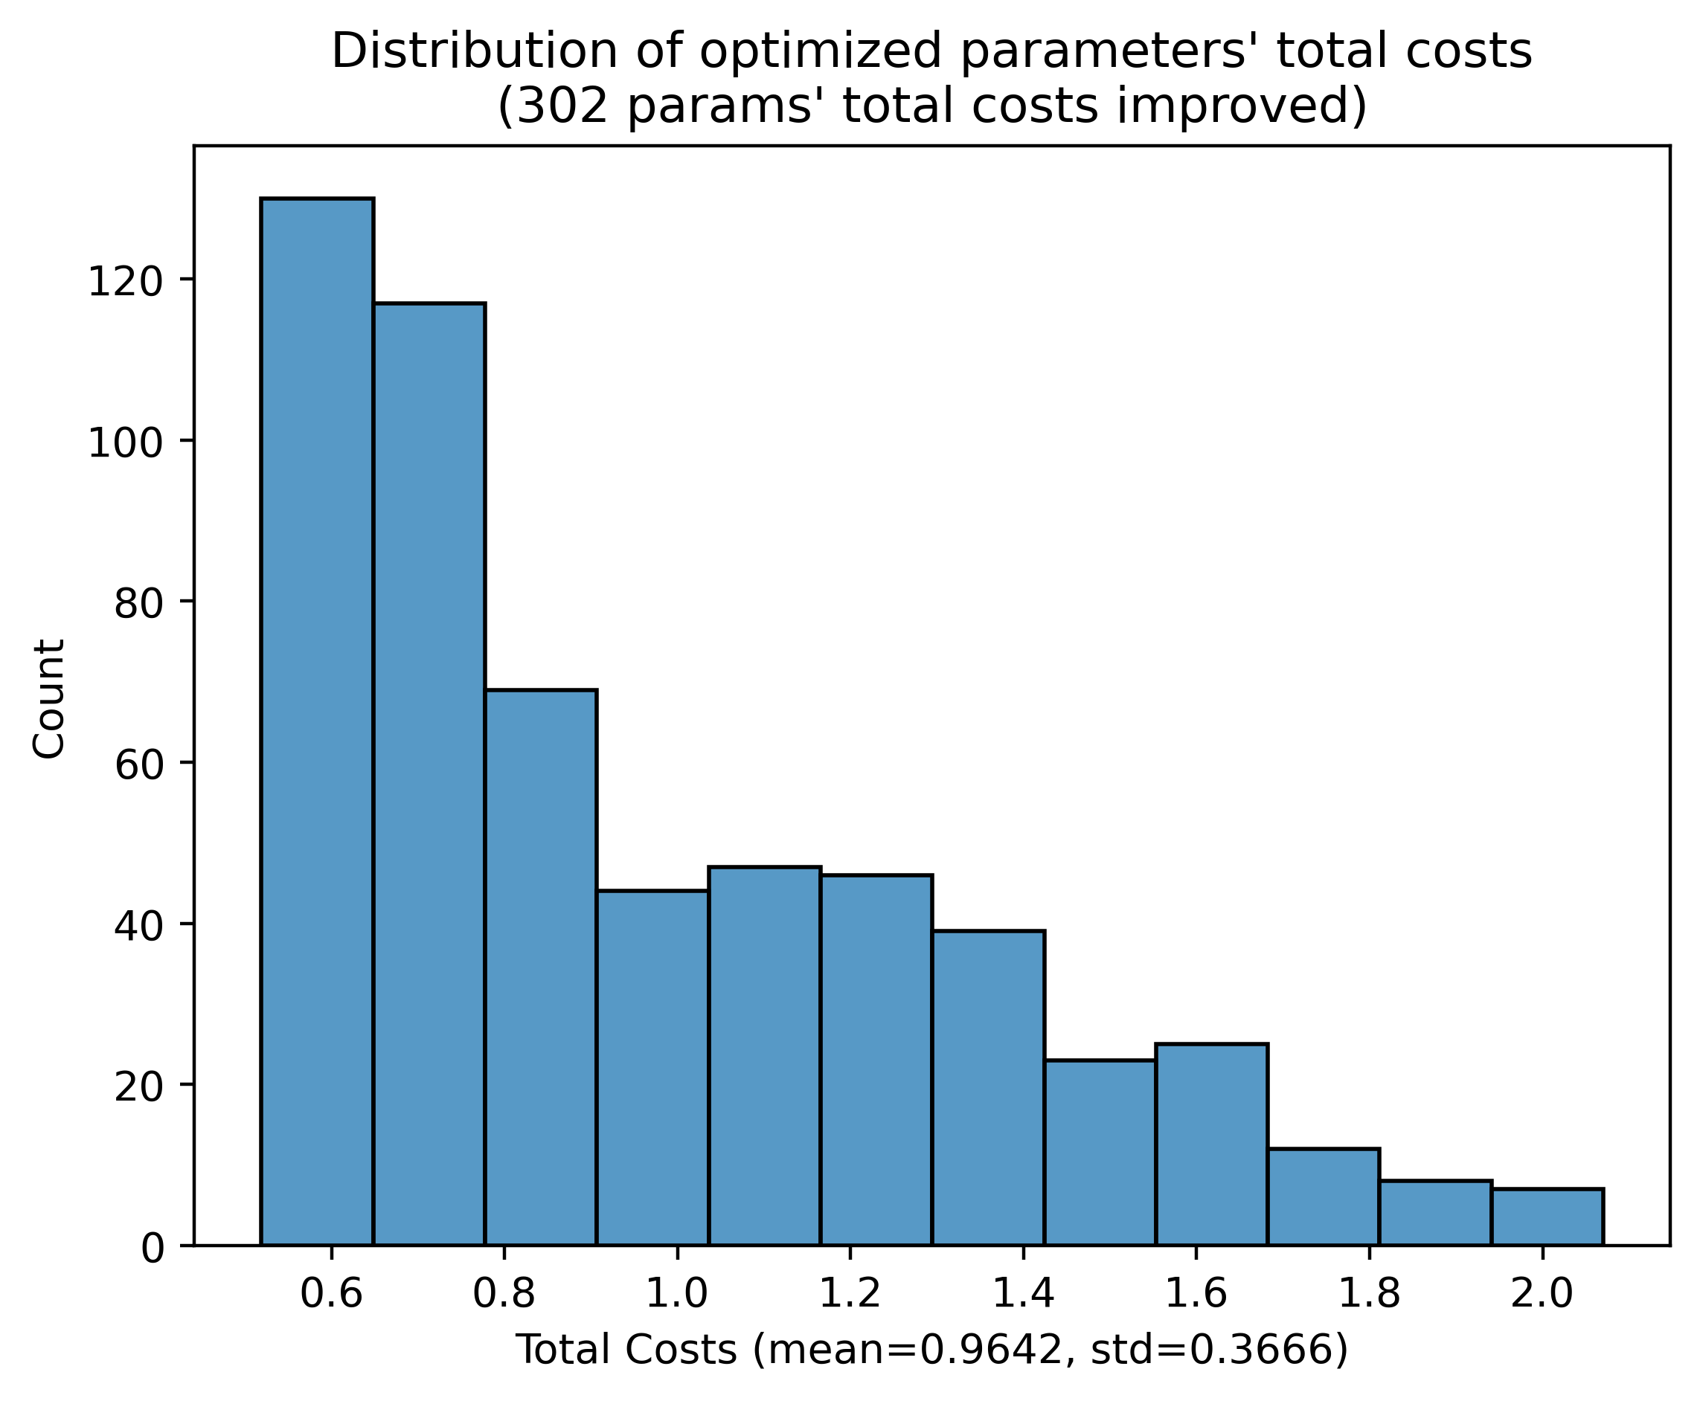
Compare Initial Params and Optimized Params
Total cost distribution of the initial 570 parameters
Total cost distribution of the optimized 570 parameters
Total cost refers to costs generated by pMFM

Slide 20
Parameter optimization using Gradient Descent with DL Model

Slide 21
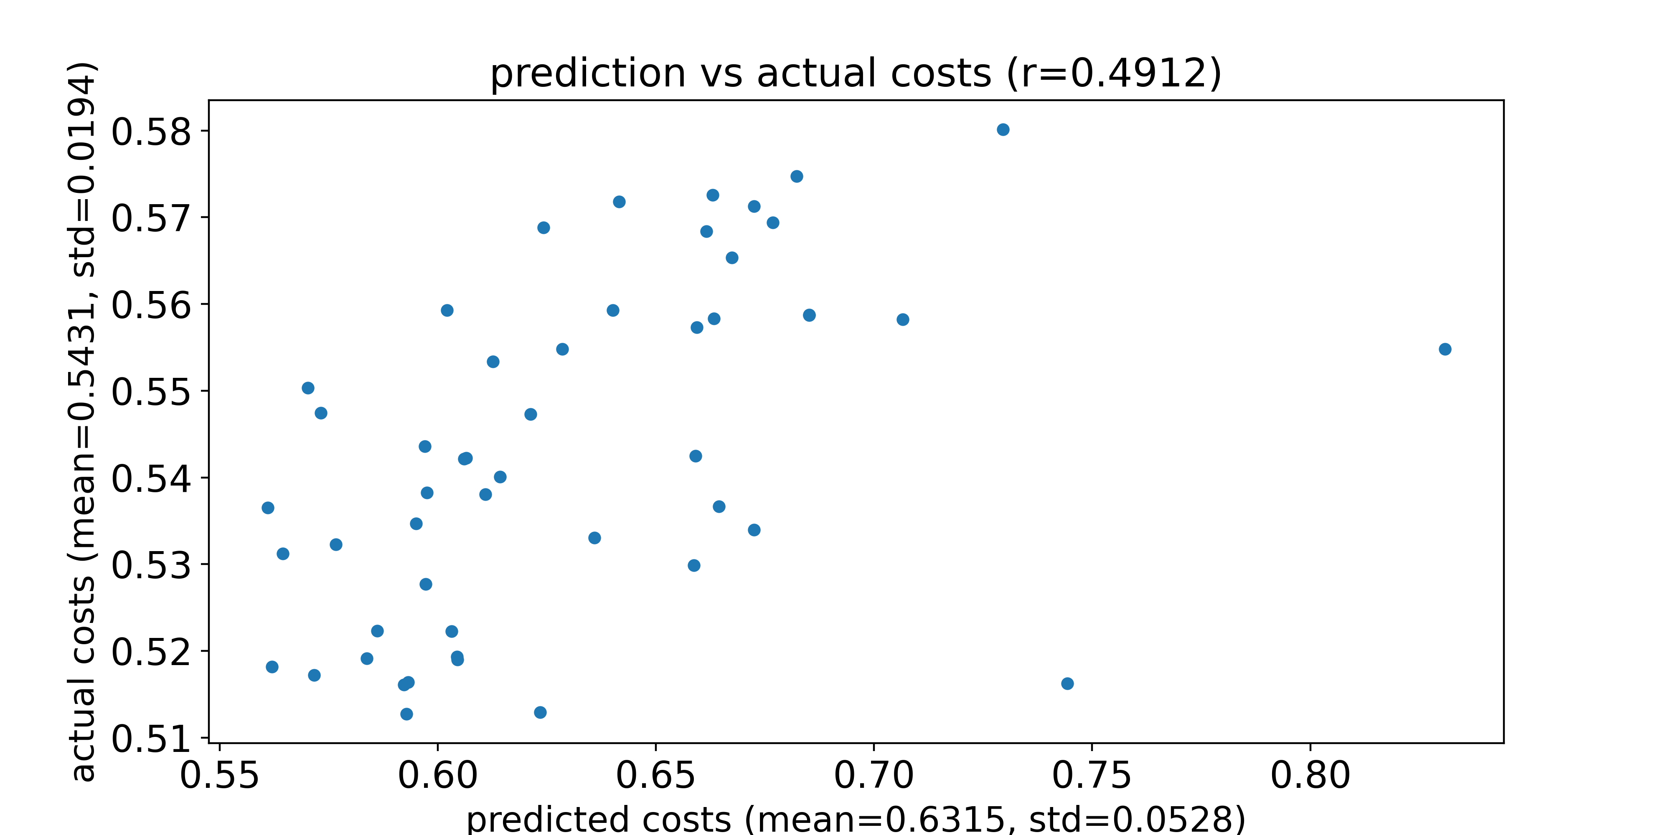
Compare prediction and actual total costs
DL model used is trained naïve net without SC
Feed the 50 params with best actual costs and an SC from a test sample into pMFM, and compare the prediction and the actual costs
Dots with an actual cost of 3 represent parameters that generate NaN using Euler forward simulation
Predicted costs and actual costs for an SC from a test sample
actual costs refers to costs generated by pMFM

Slide 22
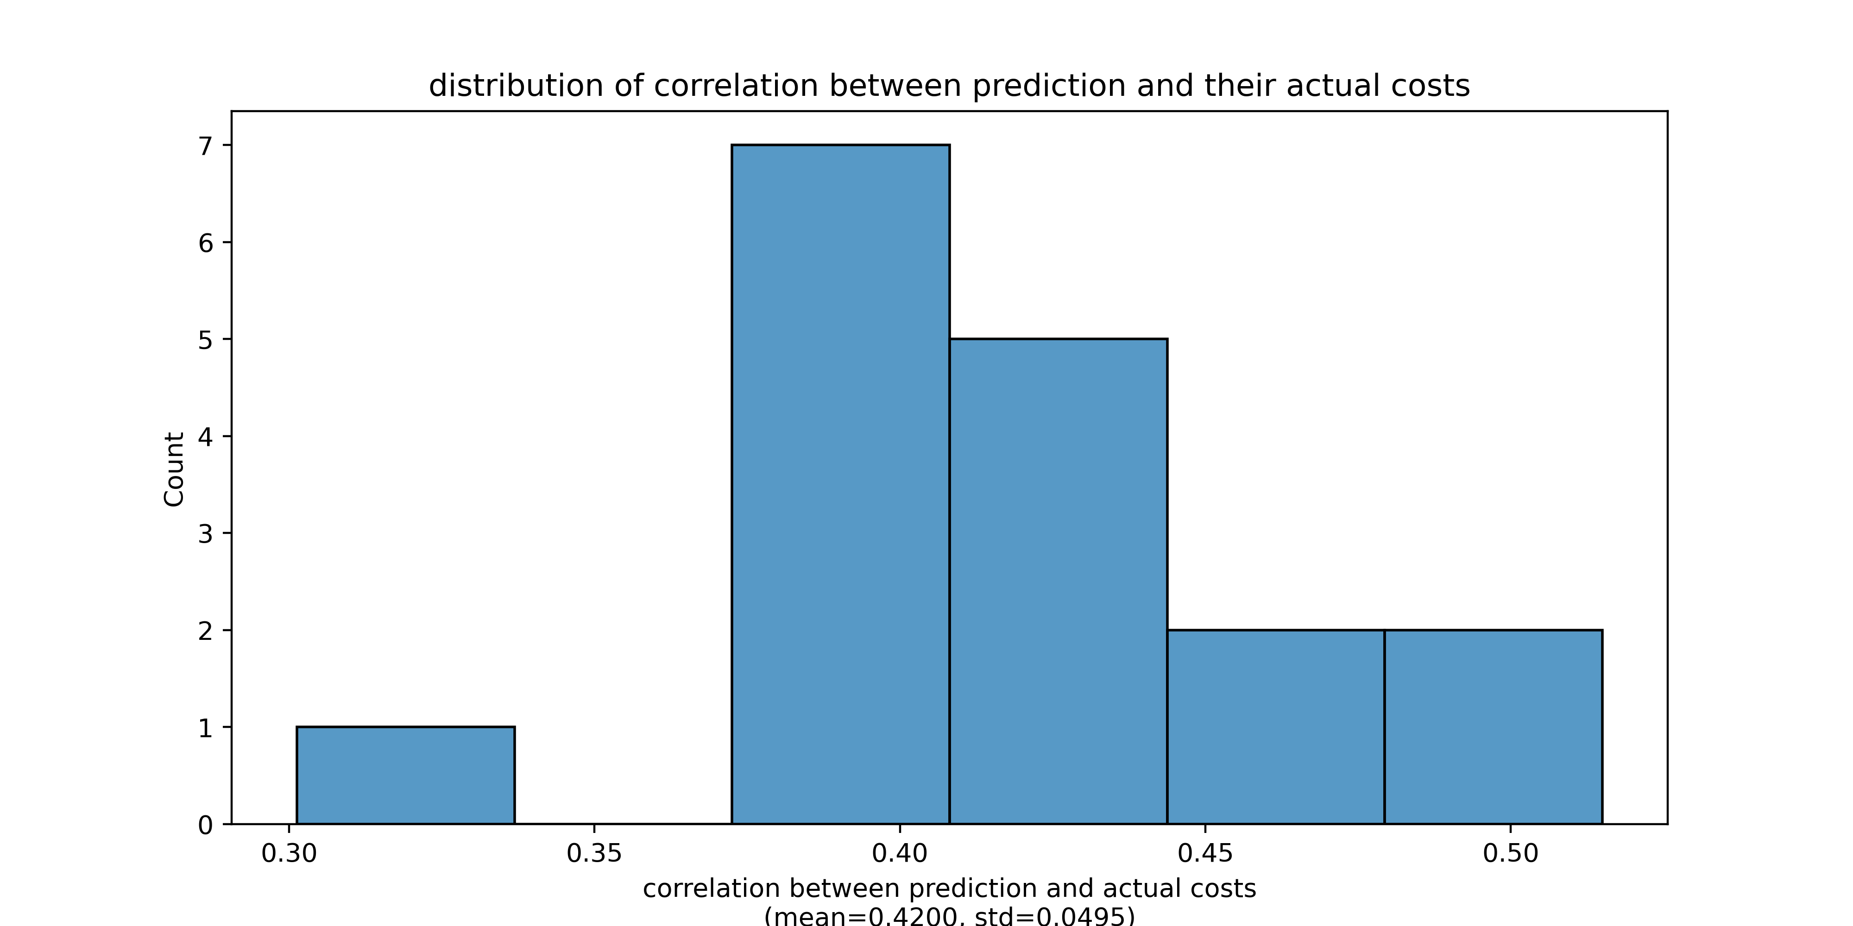
Compare prediction and actual total costs
DL model used is trained naïve net without SC
Feed the 50 params with best actual costs and an SC from a test sample into pMFM, and compare the prediction and the actual costs
Dots with an actual cost of 3 represent parameters that generate NaN using Euler forward simulation
Distribution of correlation when we use different test SC

Slide 23
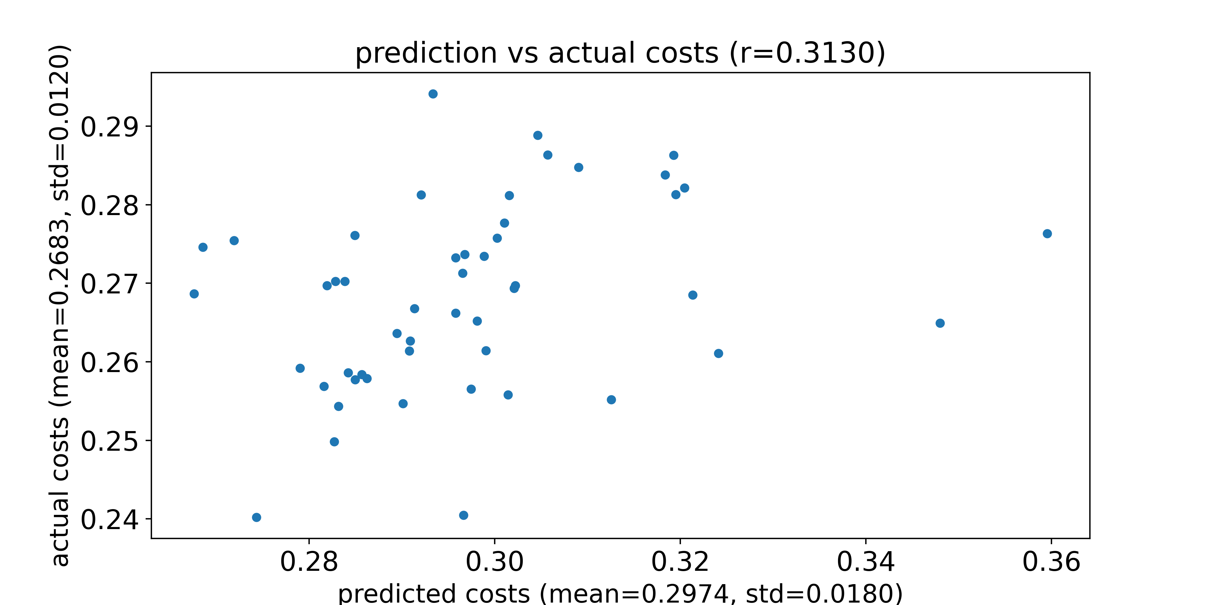
Compare prediction and actual FC_CORR costs
DL model used is trained naïve net without SC
Feed the 50 params with best actual costs and an SC from a test sample into pMFM, and compare the prediction and the actual costs
Dots with an actual cost of 1 represent parameters that generate NaN using Euler forward simulation
Predicted costs and actual costs for an SC from a test sample

Slide 24
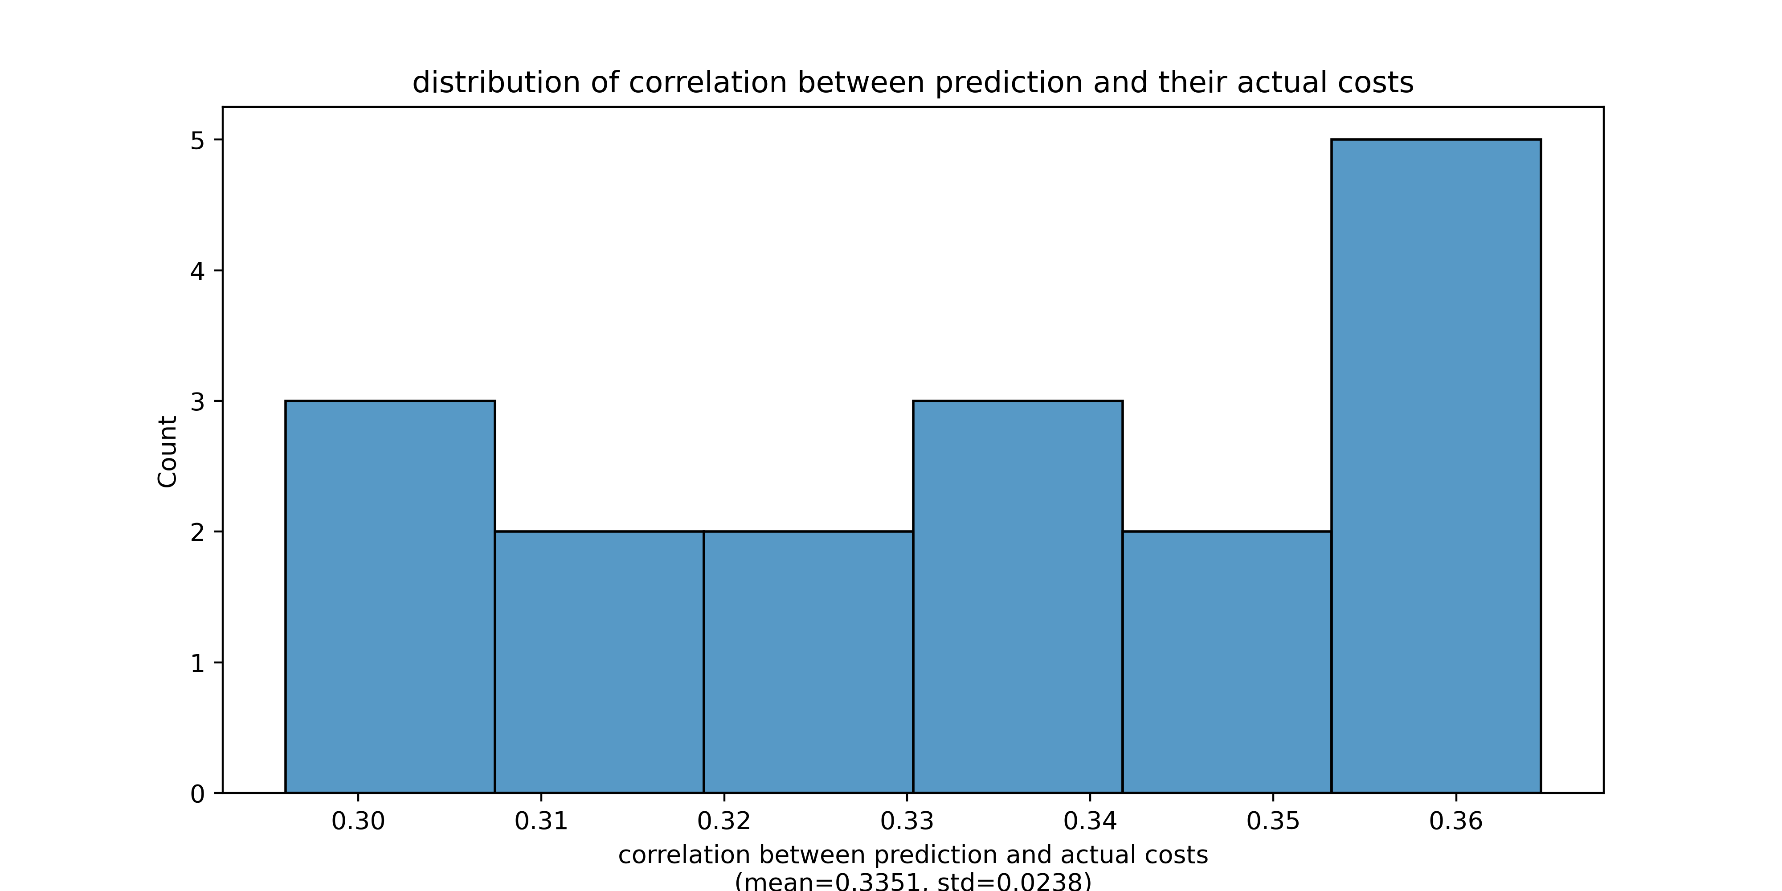
Compare prediction and actual FC_CORR costs
DL model used is trained naïve net without SC
Feed the 50 params with best actual costs and an SC from a test sample into pMFM, and compare the prediction and the actual costs
Dots with an actual cost of 1 represent parameters that generate NaN using Euler forward simulation
Distribution of correlation when we use different test SC

Slide 25
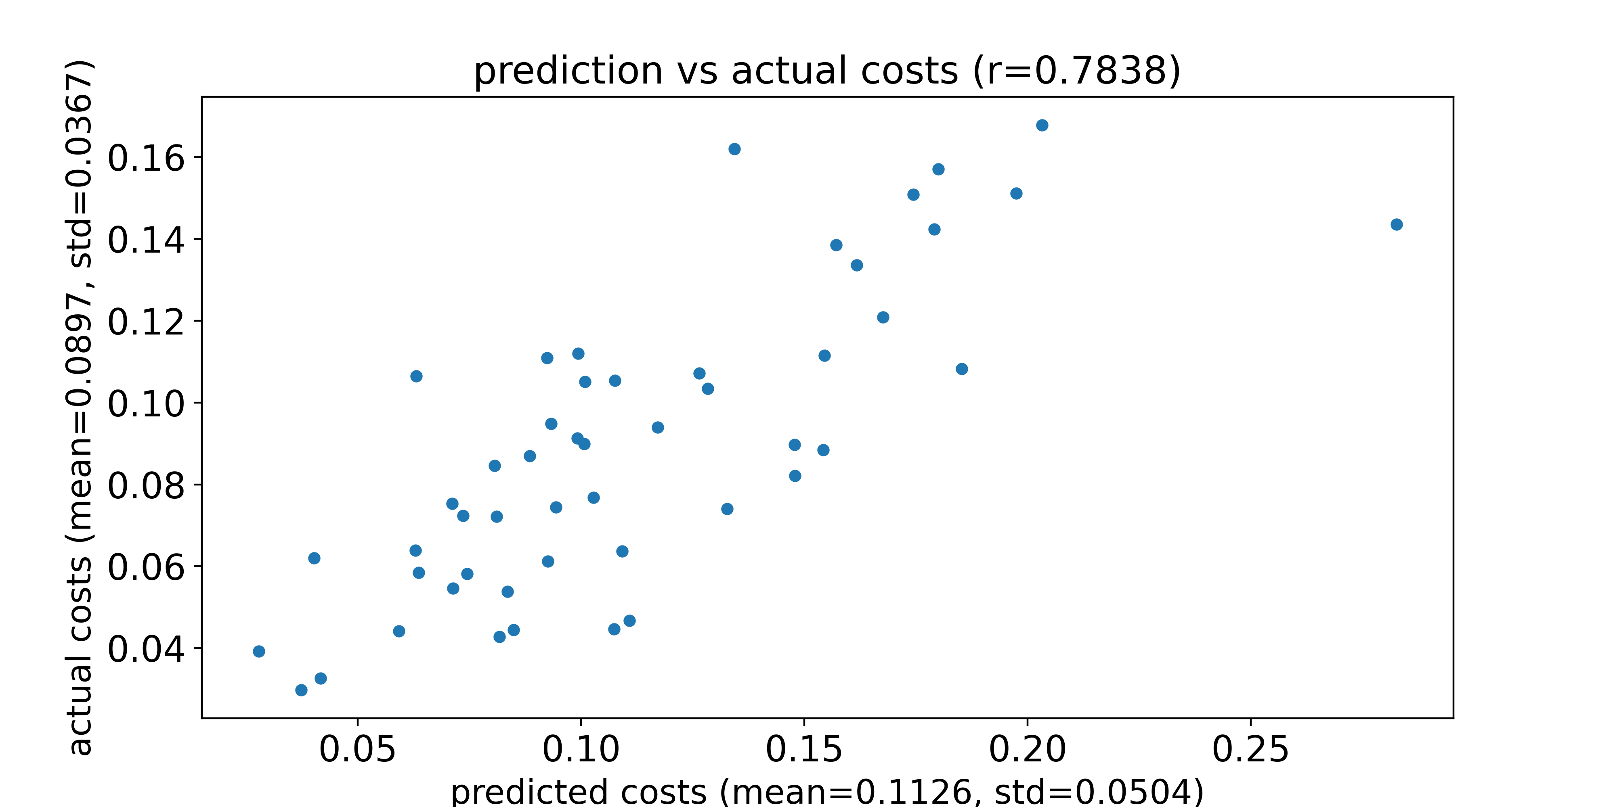
Compare prediction and actual FC_L1 costs
DL model used is trained naïve net without SC
Feed the 50 params with best actual costs and an SC from a test sample into pMFM, and compare the prediction and the actual costs
Dots with an actual cost of 1 represent parameters that generate NaN using Euler forward simulation
Predicted costs and actual costs for an SC from a test sample

Slide 26
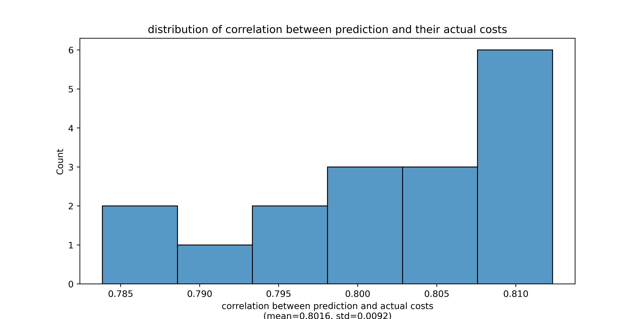
Compare prediction and actual FC_L1 costs
DL model used is trained naïve net without SC
Feed the 50 params with best actual costs and an SC from a test sample into pMFM, and compare the prediction and the actual costs
Dots with an actual cost of 1 represent parameters that generate NaN using Euler forward simulation
Distribution of correlation when we use different test SC

Slide 27
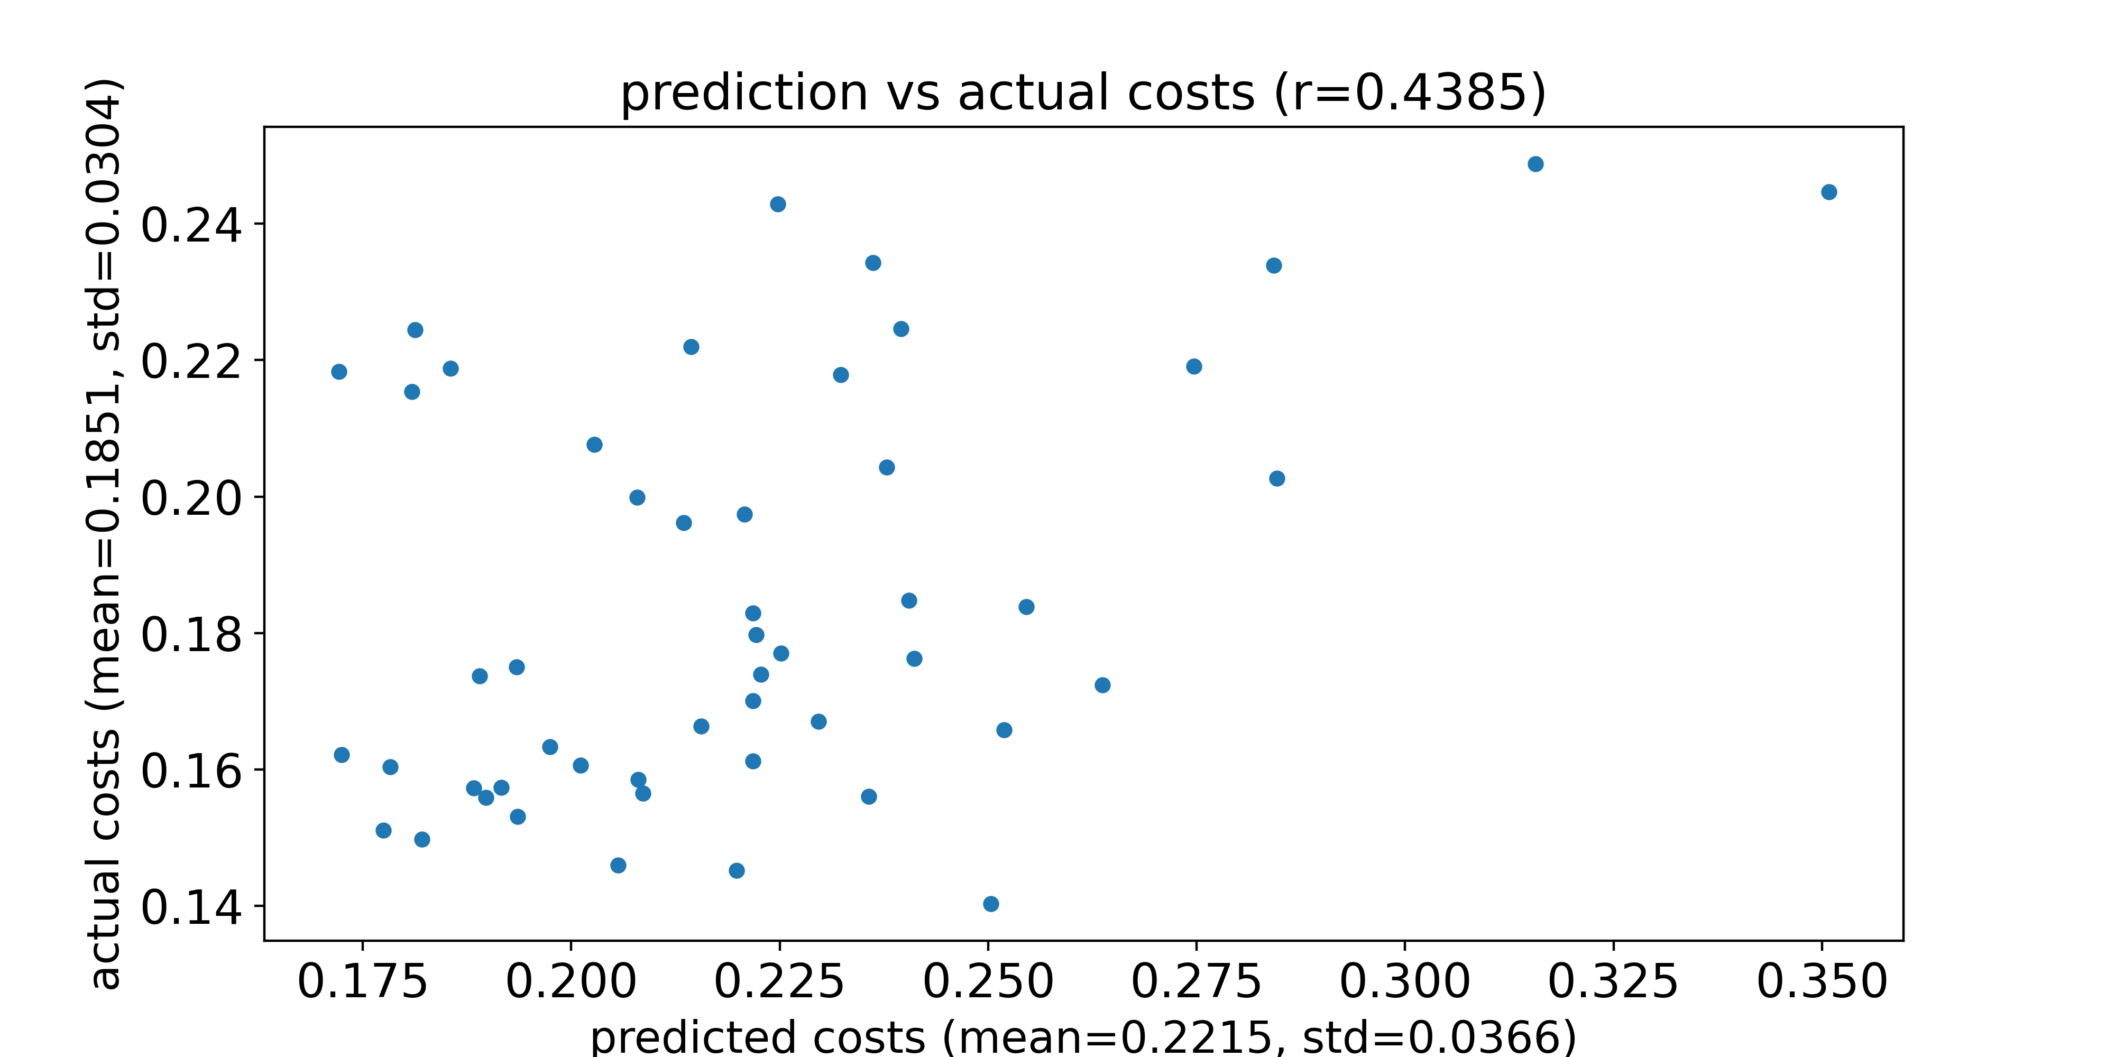
Compare prediction and actual FCD_KS costs
DL model used is trained naïve net without SC
Feed the 50 params with best actual costs and an SC from a test sample into pMFM, and compare the prediction and the actual costs
Dots with an actual cost of 1 represent parameters that generate NaN using Euler forward simulation
Predicted costs and actual costs for an SC from a test sample

Slide 28
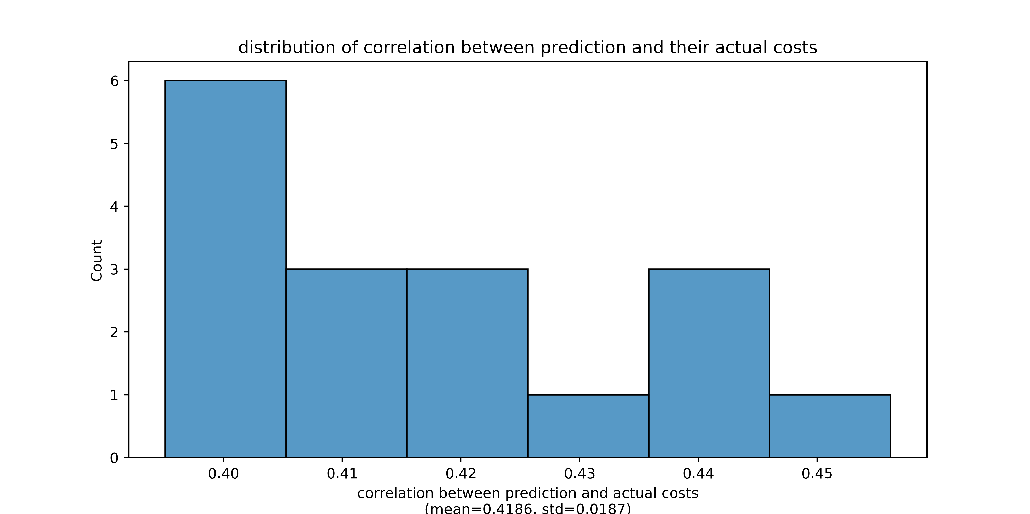
Compare prediction and actual FCD_KS costs
DL model used is trained naïve net without SC
Feed the 50 params with best actual costs and an SC from a test sample into pMFM, and compare the prediction and the actual costs
Dots with an actual cost of 1 represent parameters that generate NaN using Euler forward simulation
Distribution of correlation when we use different test SC

Slide 29
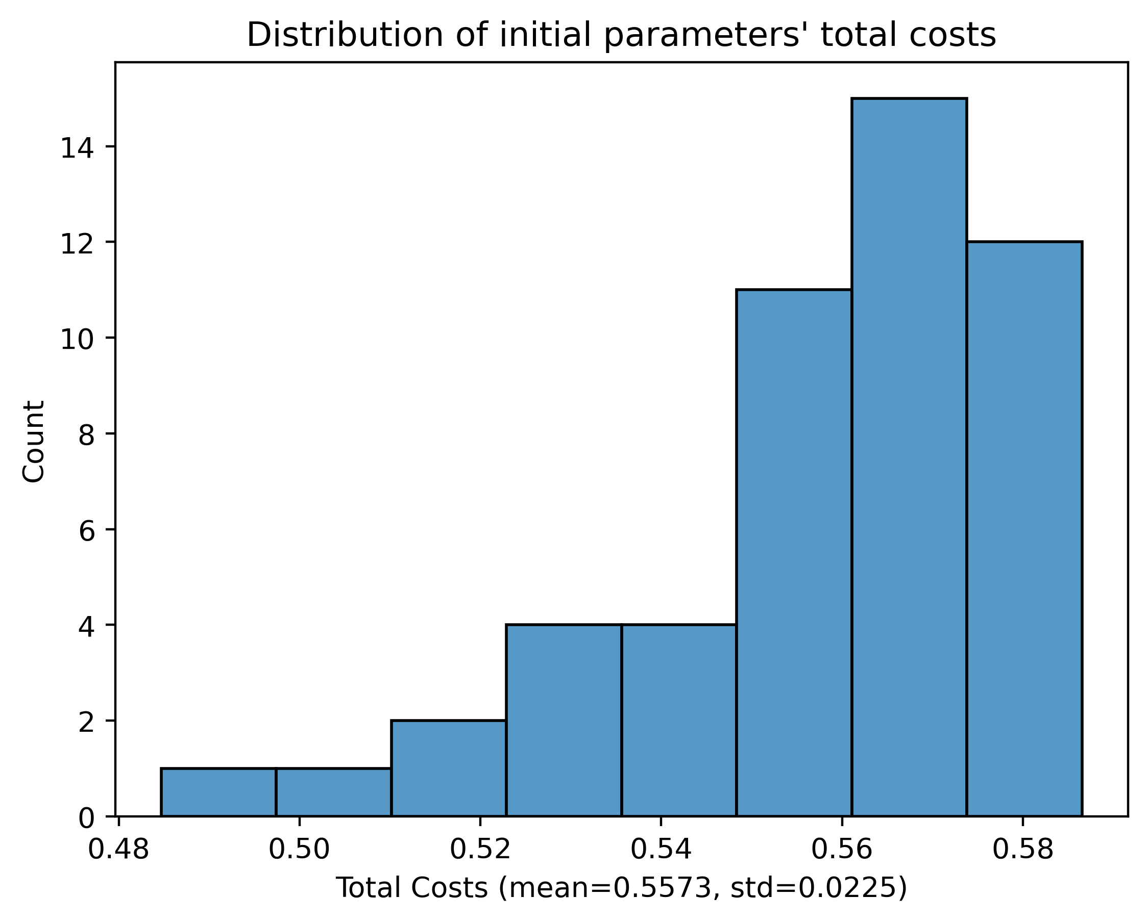
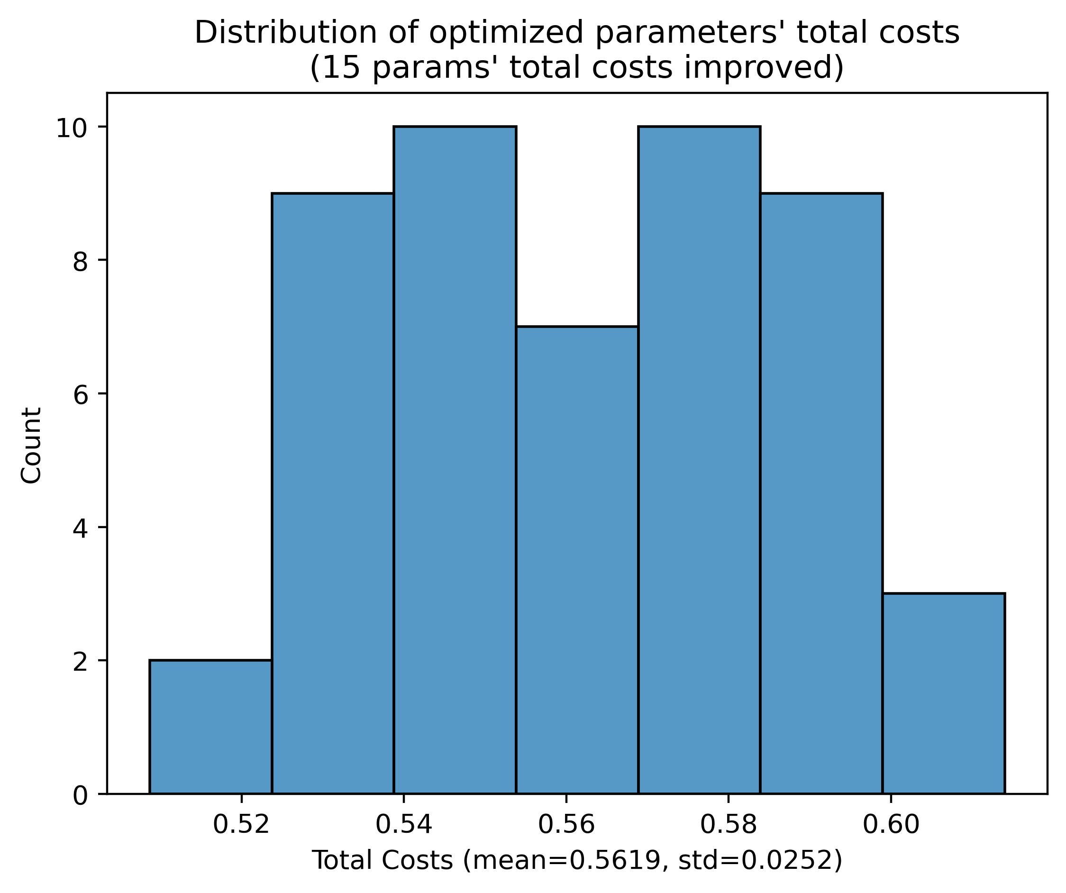
Compare Top 50 Initial Params and the 50 Optimized Params at the end
Total cost distribution of the top 50 initial parameters
Total cost distribution of the 50 optimized parameters at the end

Slide 30
Thank you

